Slide 1
SBS Collaboration
July. 22, 2018
GMn Preparation Status
Overview
Scheduling
Run Plan
Hardware/DAQ/Software Status

Slide 2
Overview
E12-09-019 (GMn) Precision Measurement of the Neutron Magnetic Form Factor up to Q²=13.5 (GeV/c)² by the Ratio Method
B. Quinn, J. Annand, R. Gilman, B. Wojtsekhowski
Hall A collab
Approved by PAC 34
PAC 35 allocated 25 of requested 31 days.

Slide 3
Technique
Many systematic effects (experimental and theory) cancel in ratio.
Expect very small correction for Electric because small
form factor and large kinematic weighting of Magnetic

Slide 4
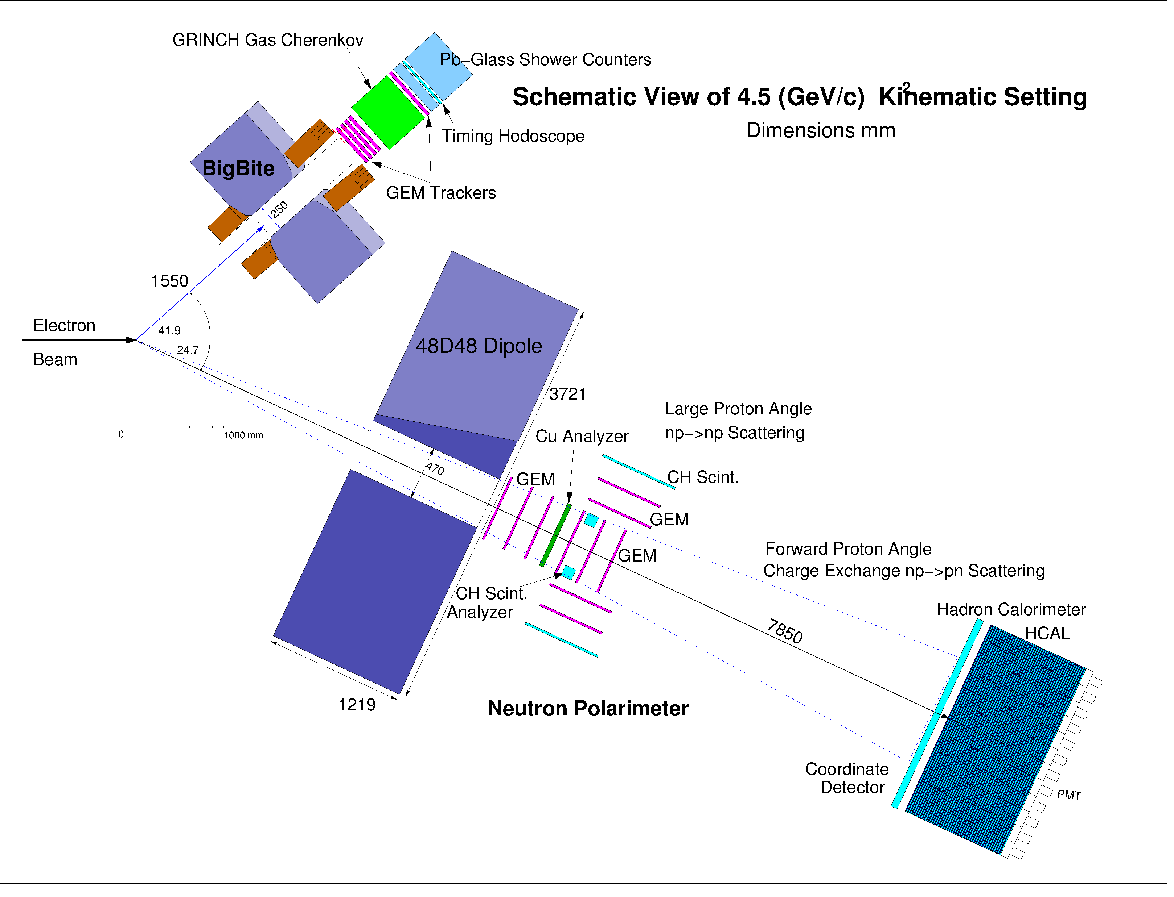
Schematic Experiment Layout
BigBite as electron arm (Beam left)
Identifies q-vector
Fiducial cut in BigBite selects high,
matched acceptance for n and p.
48D48 (SBS spectrometer magnet)
Deflects protons vertically on HCal-J
to distinguish from neutrons
HCAL flight path 6.2 - 17m
HCal-J as hadron detector with CDet in front (Beam right)

Slide 5
GMn ERR
July 27/17 GMn passed ERR
Still work to do on OSPs, ESAD…

Slide 6
Scheduling
As of Feb. meeting…
2019 APEX, PREX2, CREX but PREX2 can run only IF summer run for 2019 is approved.
Best case SBS installs at beginning of 2020 and GMn runs in fall.
…. any problems (or no summer run) SBS may be pushed into 2021.
Many simultaneous projects… need more collaboration support than usual… (entire SBS collaboration benefits from keeping installation on schedule)
New paradigm: optimize physics output from running period rather than focus on PAC-approved hours: => GMn gets whole running period BUT only one running period
Continue to work on optimizing run plan, angle changes, HCal moves, etc.
If GMn commissioning schedule continues to slip……

Slide 7
Run Plan
proposed
configuration |  | Q² | E_{Beam} | θ_{BB} | θ_{SBS} | d_{BB} | d_{48D48} | 48D48 field |  | Luminosity |  | dHCal
 |  | (GeV/c)² | (GeV) | (deg.) | (deg.) | (m) | (m) | integral (T-m) |  | (10³⁸/A/cm²/s) |  | (m)
1 |  | 3.5 | 4.4 | 32.5 | 31.1 | 1.80 | 2.00 | 1.40 |  | 0.7 |  | 6.2
2 |  | 4.5 | 4.4 | 41.9 | 24.7 | 1.55 | 2.25 | 1.70 |  | 1.4 |  | 6.2
3 |  | 6.0 | 4.4 | 64.3 | 15.6 | 1.55 | 2.25 | 0.70 |  | 2.8 |  | 11
4 |  | 8.5 | 6.6 | 46.5 | 16.2 | 1.55 | 2.25 | 1.20 |  | 2.8 |  | 11
5 |  | 10.0 | 8.8 | 33.3 | 17.9 | 1.75 | 2.25 | 1.30 |  | 1.4 |  | 13
6 |  | 12.0 | 8.8 | 44.2 | 13.3 | 1.55 | 2.25 | 1.20 |  | 2.8 |  | 14
7 |  | 13.5 | 8.8 | 58.5 | 9.8 | 1.55 | 3.10 | 0.70 |  | 2.8 |  | 17
8 & 9 |  | 3.5/6.0
calibration of HCal using L-HMS at kinematics of config. 1 &3
modified
configuration |  | Q² | E_{Beam} | θ_{BB} | θ_{SBS} | d_{BB} | d_{48D48} | 48D48 field |  | Luminostiy |  | dHCal
 |  | (GeV/c)² | (GeV) | (deg.) | (deg.) | (m) | (m) | integral (T-m) |  | (10³⁸/A/cm²/s) |  | (m)
1 |  | 3.5 | 4.4 | 32.5 | 31.1 | 1.80 | 2.00 | 1.71 |  | 0.7 (2.8 | ?) | 7.2
2 |  | 4.5 | 4.4 | 41.9 | 24.7 | 1.55 | 2.25 | 1.71 |  | 1.4(2.8 | ?) | 8.5
3 |  | 5.7 | 4.4 | 58.4 | 17.5 | 1.55 | 2.25 | 1.71 |  | 2.8 |  | 11
4 |  | 8.1 | 6.6 | 43.0 | 17.5 | 1.55 | 2.25 | 1.65 |  | 2.8 |  | 11
5 |  | 10.2 | 8.8 | 34.0 | 17.5 | 1.75 | 2.25 | 1.60 |  | 1.4(2.8 | ?) | 11
6 |  | 12.0 | 8.8 | 44.2 | 13.3 | 1.55 | 2.25 | 1.50 |  | 2.8 |  | 14
7 |  | 13.5 | 11.0 | 33.0 | 14.8 | 1.55 | 3.10 | 0.97 |  | 2.8 |  | 17
 |  |  |  | θ_{L-HRS}
8 |  | 6.06 | 4.4 | 61.1,64.3 | 14.8 |  | 3.10 | 1.71 |  | 0.93 |  | 17
 |  |  |  | 67.5,70.7
9 |  | 4.4 | 4.4 | 39.,42. | 25.5 |  | 3.10 | 1.71 |  | 0.93 |  | 17

Slide 8
Schematic Experiment Layout with GEn
4.5 (GeV/c)² Kinematic Setting
HCAL flight path 6.2 - 17m
Analyzer and GEM trackers for G_{en}/G_{mn}
Remove analyzer blocks for G_{Mn}/G_{Mp}
In-acceptance GEMs may be useful for G_{Mn}/G_{Mp}

Slide 9
 | config |  | Changes required
 | 1
 |  |  | reposition 48D48, HCal, BigBite (Insert GEn analyzer, GEn run, remove GEn analyzer before/after config. 2))
 | 2
 |  |  | reposition 48D48, HCal, BigBite
 | 3
 |  |  | Energy change, reposition BigBite
 | 4
 |  |  | Energy change, reposition BigBite
 | 5
 |  |  | reposition 48D48, HCal, BigBite
 | 6
 |  |  | reposition 48D48, HCal, HRS , BigBite change beam pipe Energy change
 | 7
 |  |  | Energy change/rig out BigBite
 | 8 |  | 3 HRS moves (3 degrees each)
 |  |  | reposition 48D48, HCal, HRS
 | 9 |  | one HRS move (3 degrees)
Total
1 Beam set-up
4 Energy changes
5 SBS 48D48/HCal moves
No de-cabling, restacking
of HCal- move intact
7 BigBite moves
Gate valve, so no need to
bring scatt chamber up
to atmosphere
1 Change of beamline
1 Rig out BigBite
6 HRS moves

Slide 10
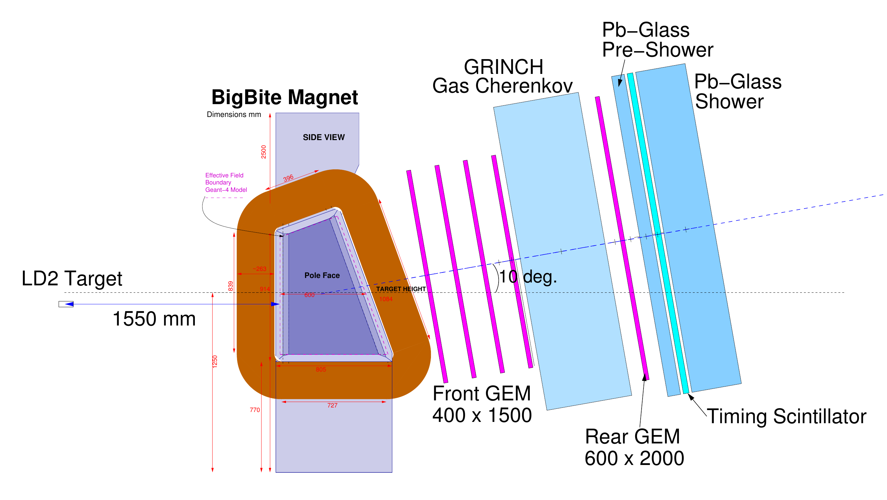
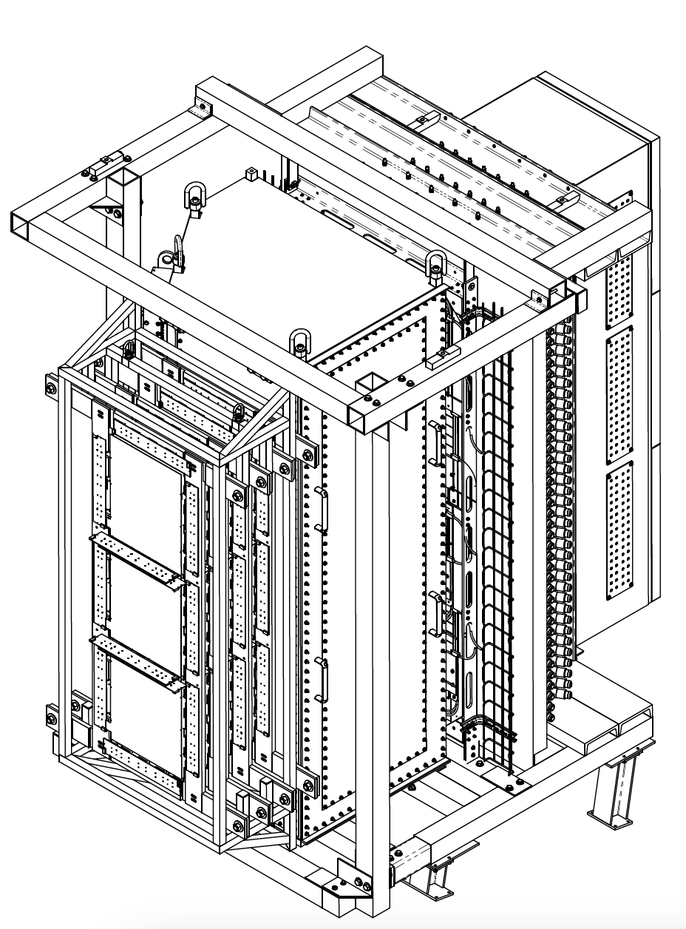
Hardware Status
BigBite as electron arm (Beam left)
Instrumented for high luminosity (GEMs)
30uA on 15cm LD2 (or 45uA on 10 cm) 1.4X10³⁸ /cm²/s
Good electron ID (preshower/shower & GRINCH)
Identifies q-vector ( )
~10 mrad resolution needed
Single-arm trigger efficiency NOT critical
Count event only if BOTH n and p would be in high-acceptance region of HCal-J
Loading of detector frame this summer
W ~ 55 msr
dp/p ~ 0.5%
dθ ~ 1 mr
dz ~ 2 mm @ target
dt ~ 150 ps

Slide 11
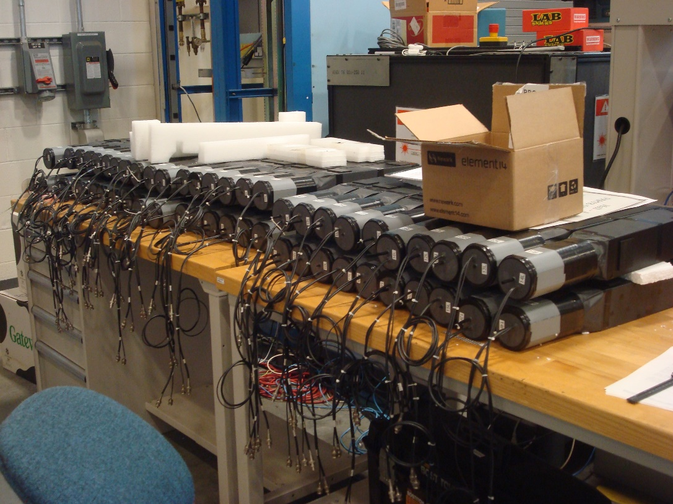
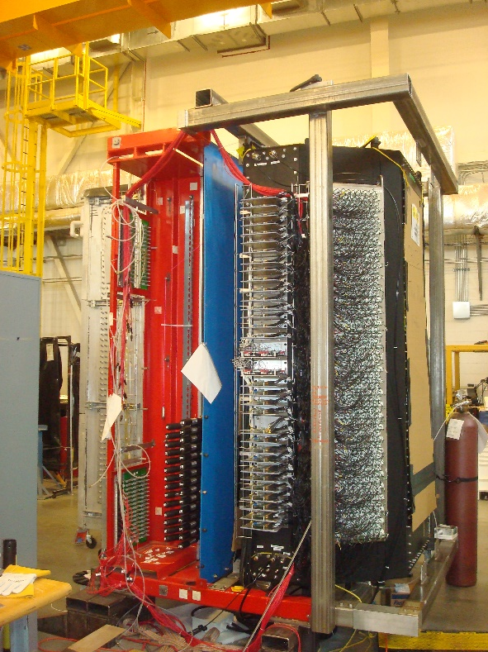
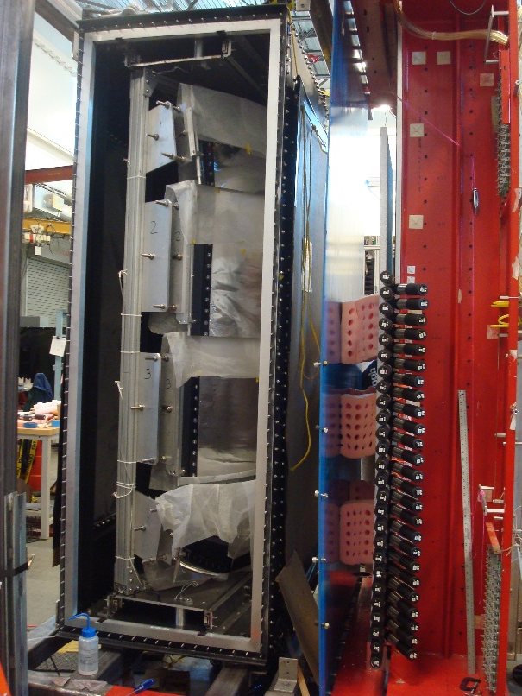
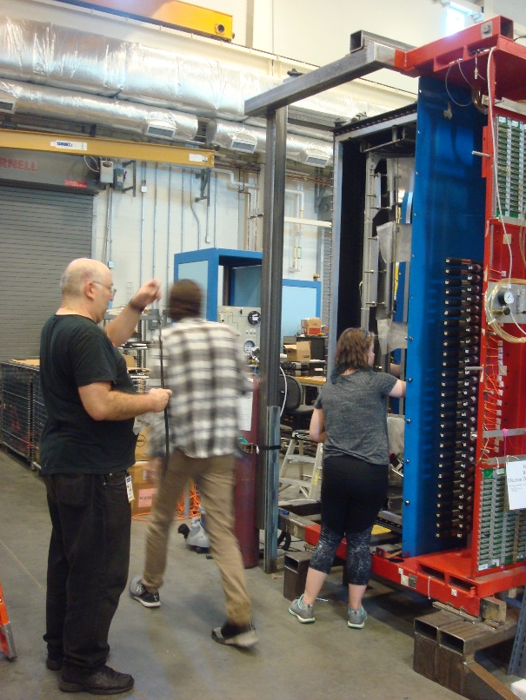
Bigbite frame in
TED high bay
Load UVa GEM?
Progress on
Grinch gas choice,
gas-tighting?
BB Hodo being loaded.
HV cables? HV/LV dist.
Move to ESB still planned?
Move of rails in hall?
Estimated manpower for re-
assembly, 20 FTE !!!!

Slide 12
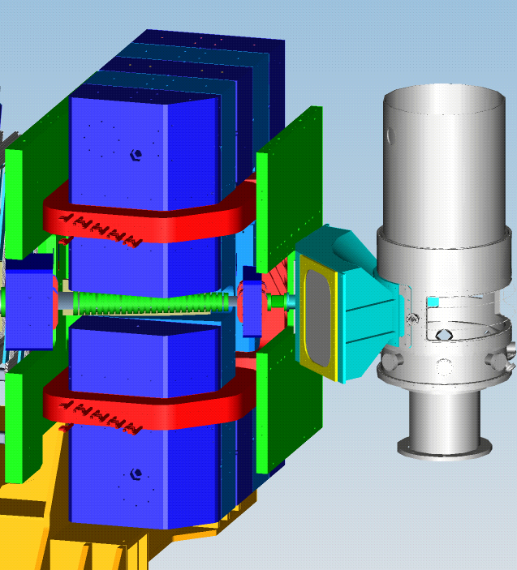
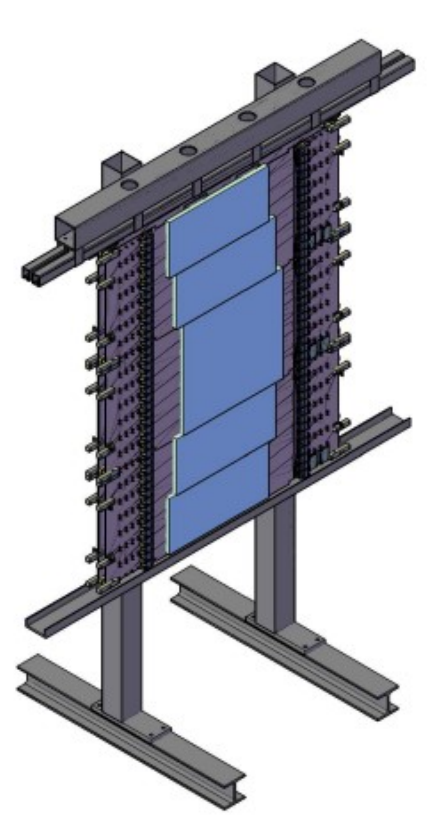
48D48 (SBS spectrometer magnet)
Up to 1.71 T-m ‘kick’ to separate protons from neutrons
Field uniformity, accurate map not important – Not used as spectrometer
Ready for installation
CDET
In front of HCal, hanging from HCal frame
Positive ID of proton (useful check for proton
efficiency calibrations).
Vertical hit position, useful for calibrating HCal-J position resolution
(not included in original proposal)
Testing of submodules in progress.

Slide 13
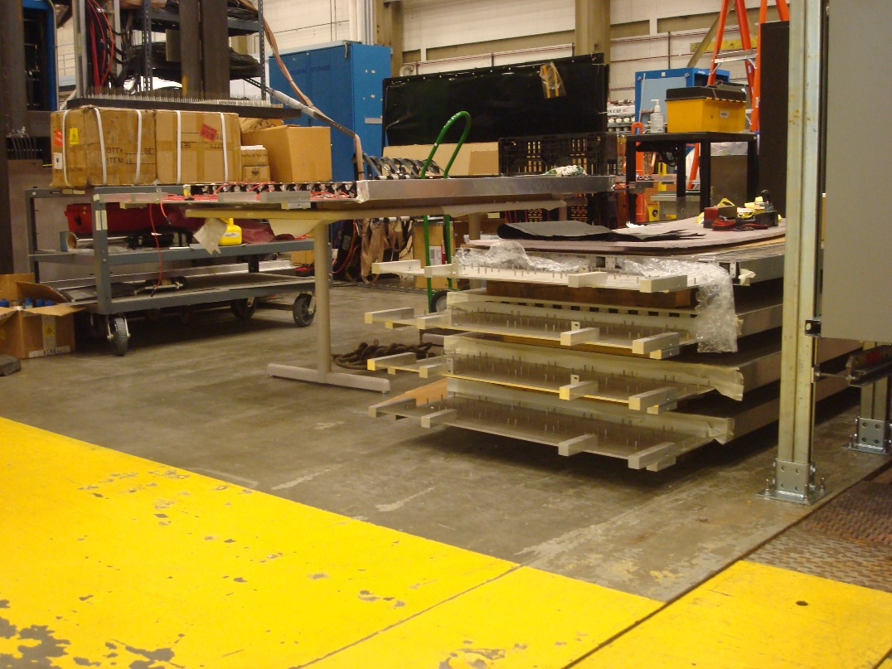
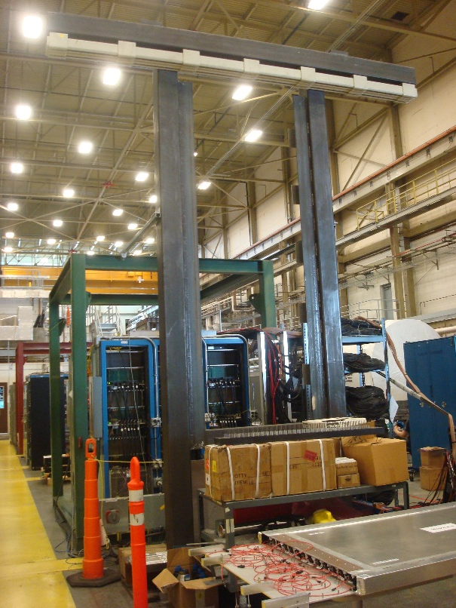
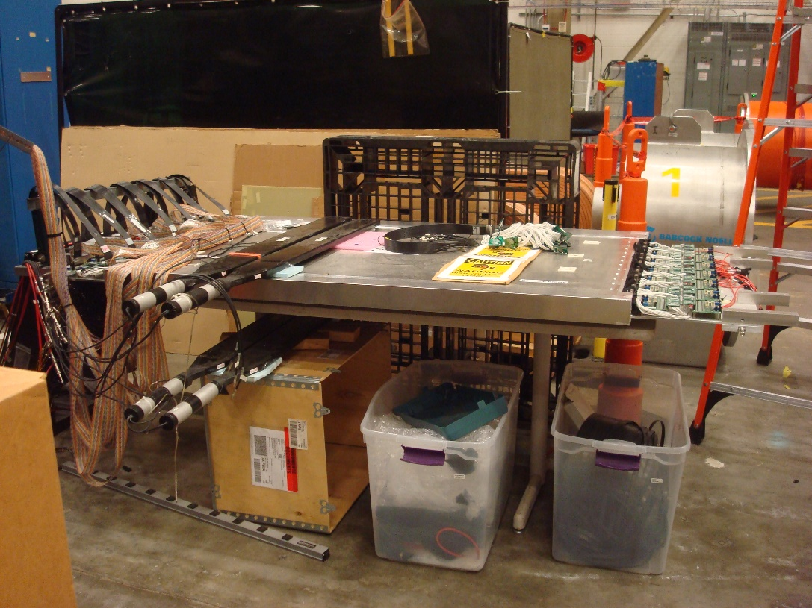
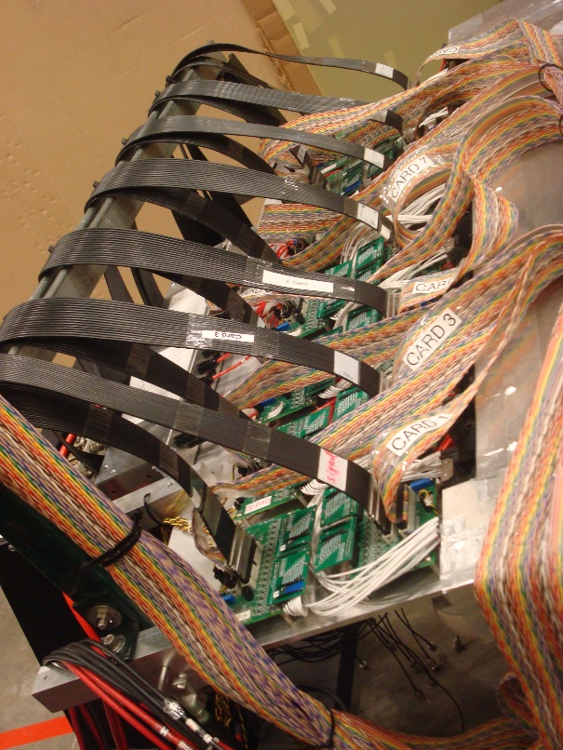
CDet
testing in
Test Lab
Capacitive
coupling
background
resolved?
Efficiency?

Slide 14
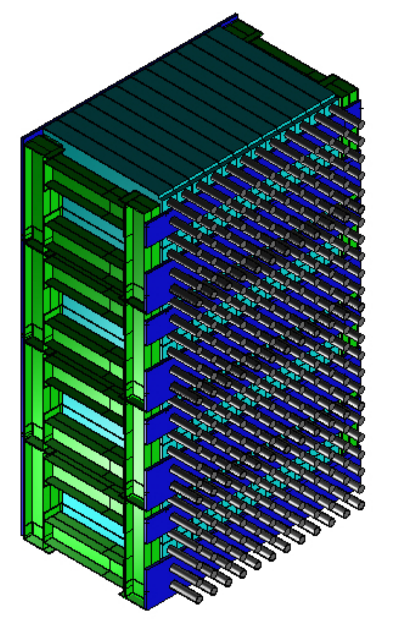
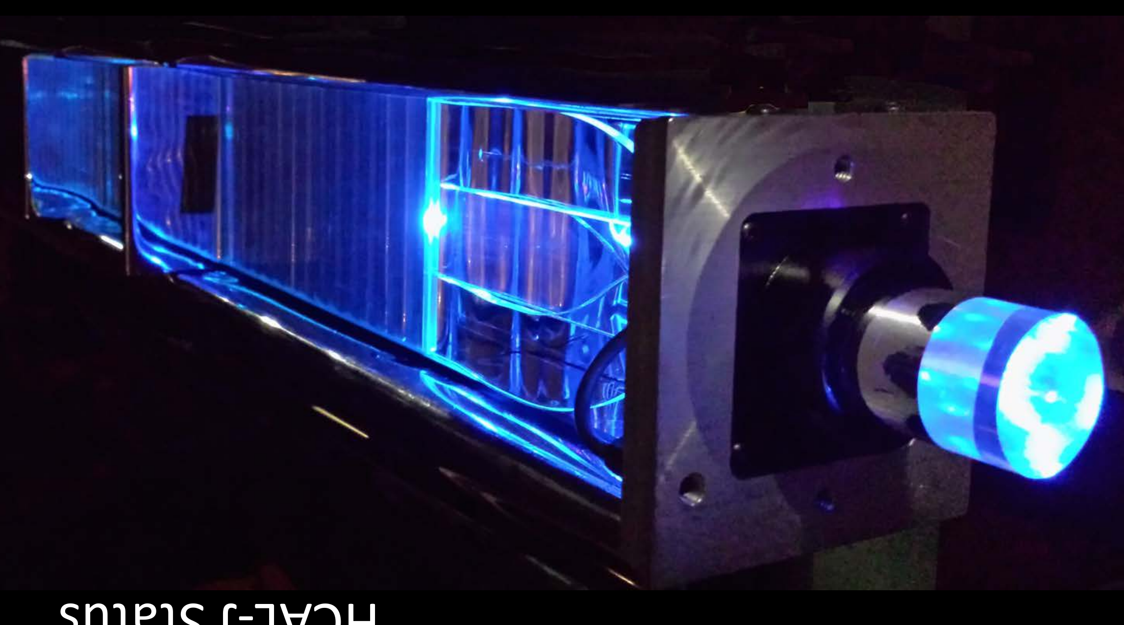
HCal-J as hadron detector (Beam right)
Similar (high) efficiency for neutrons and protons
Good position resolution to test whether hit is associated with known q-vector
Cuts inelastics. Fermi-motion sets resolution limit.
No tracking detectors needed in hadron arm
TOF information will improve inelastic rejection (not included in proposal)
All modules built. Sub-assemblies assembled. Installation of pulser system & PMTs this summer. Start calibration.
Catania (Vincenzo et al.) using cosmics and fADC DAQ to study modules’ response
>93% efficiency for
multi-GeV p and n
Effective suppression
Of soft background
~0.5 ns timing
resolution
14

Slide 15
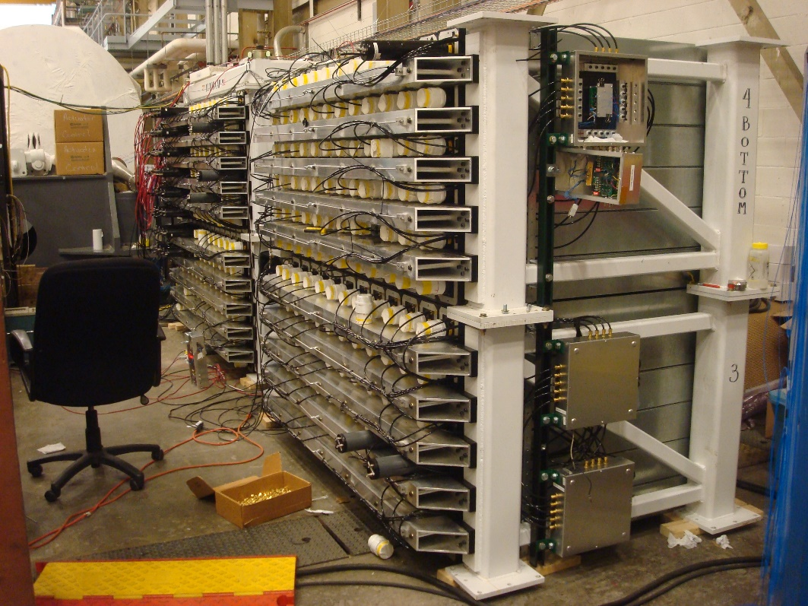
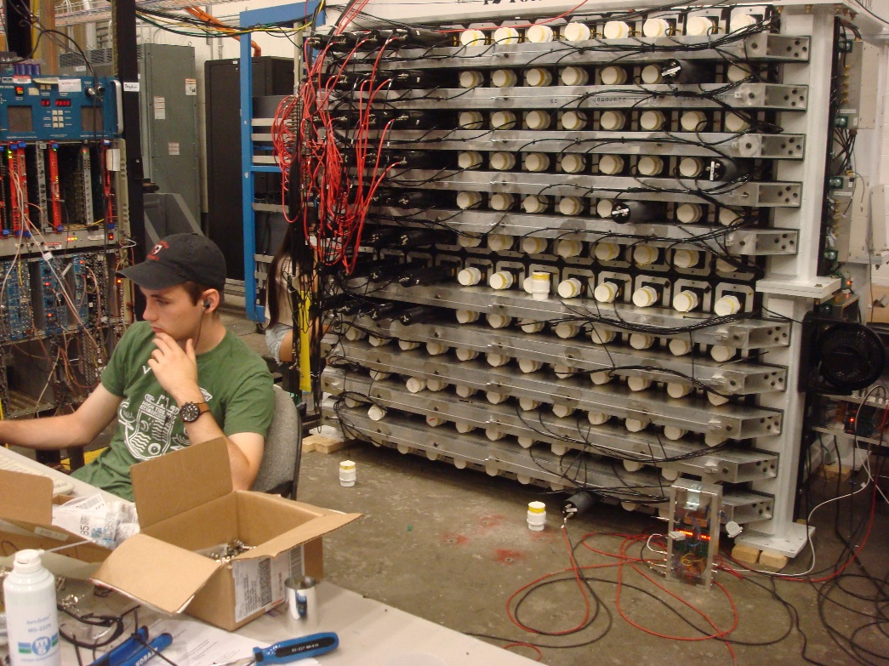
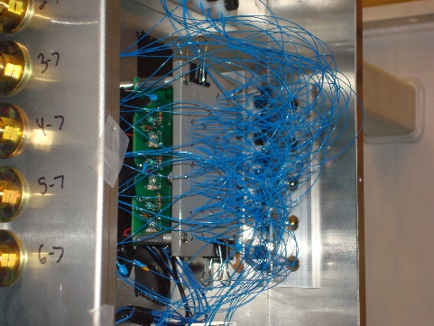
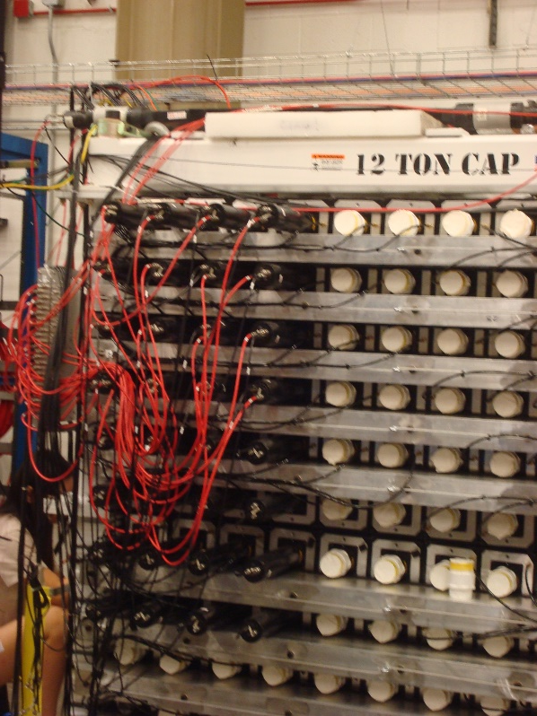
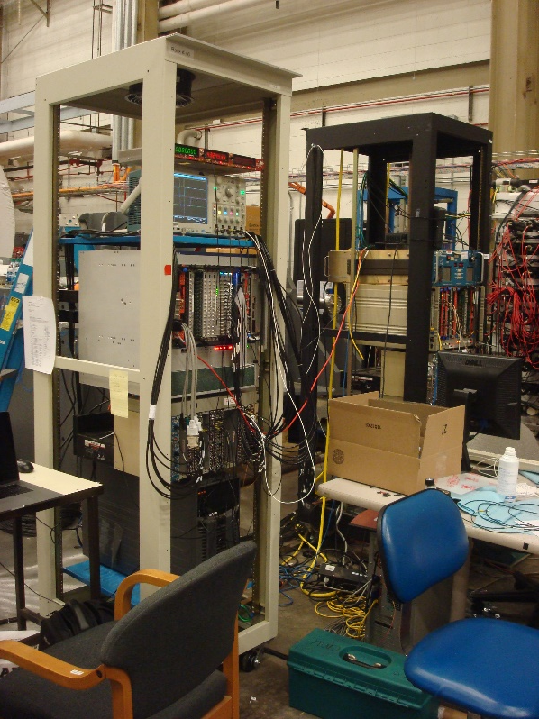
¾ of fibers
cut, bundled
Most run through tubing
to PMTs and inserted in fiber-
guide plates.
Cosmic tests on-going on 4X4
section, may expand.

Slide 16
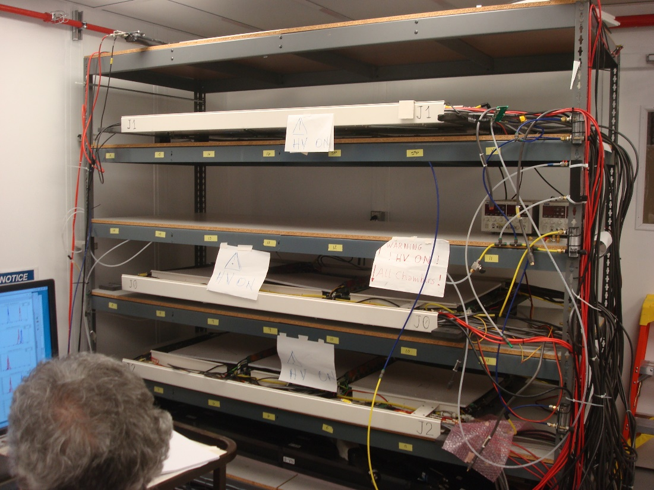
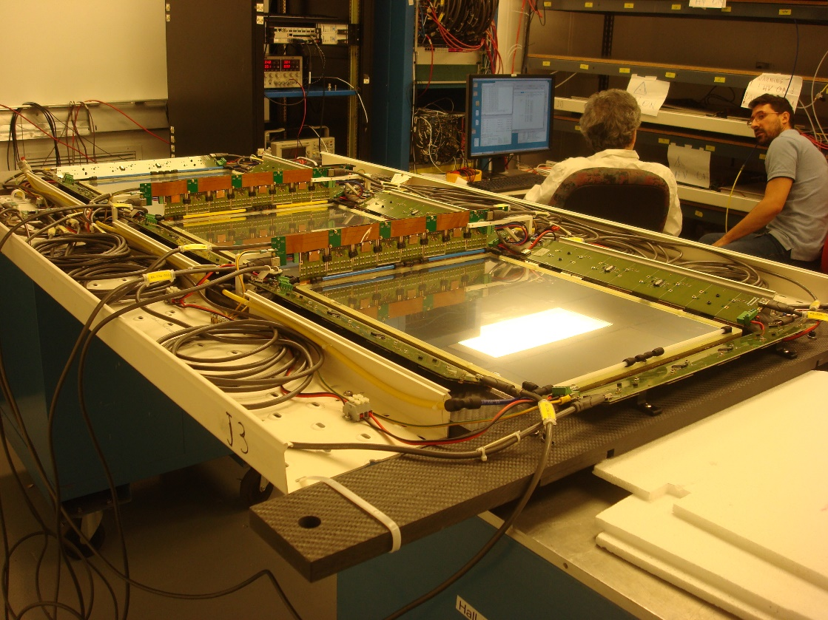
GEMs
INFN will have 4 planes plus at least one spare for GMn.
Three tested planes had 0, 3 and 2 bad sectors (may be curable).
Tracking-GEM support for BB stand can be used to hold 4 planes for testing in Hall???
…. BUT first should be mounted to BB stand and cabled up.
HV problems in one of the three planes… burning off? recoverable? Grease????

Slide 17
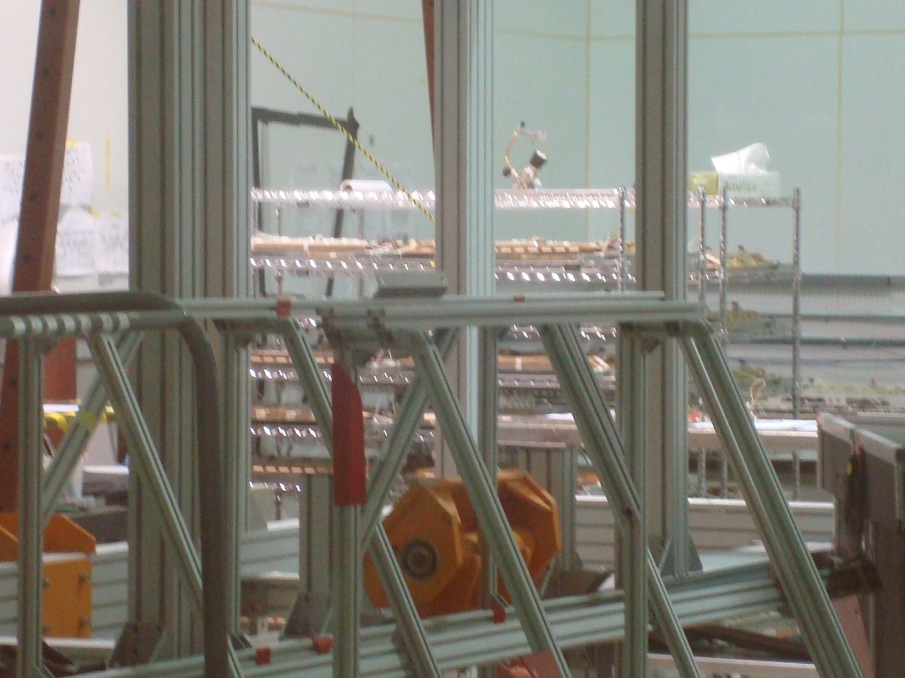
One UVa GEM plane needed for Bigbite (more for GEn polarimeter).
Kondo and Siyu to work on preparation, testing and commissioning of planes.
Patch from “5-pair HDMI” to standard “4-pair HDMI”
UVa cosmic-ray testing in EEL clean room

Slide 18
GEM readout
MPD to SSP and MPD to VME issues resolved
Extensive testing at JLab planned.
Zero-suppression algorithm
Simulated data being used to test cluster algorithm
~100 kHz/cm^2 bkg, mostly e- (including photon-produced)
20% occupancy, common for primary hit to overlap background
Reconstructed hit eff: ~75%?

Slide 19
DAQ
Expected GMn trigger rates <5 kHz at low Q^2, <500 Hz at high Q^2 (but high occupancy)
Single-electron trigger good option
MPD to SSP and SSP to ROC can handle 5 kHz
GEMs ~220 MB/s
Ben Raydo to implement first pass SSP reduction this summer
Bigbite, HCal, CDet small data rate
(F1 or VETROC for high resolution TDC with BigHAND LE disc.).
58 MB/s at 100% occupancy
Network upgrade? $30k needed for GMn
6 FADCs $ 27k, VXS crate $15k needed for GMn

Slide 20
Software
Decoders for everything ready
Analyzer frameworks for all detectors?
Event display, experiment-specific analysis still being done.
Commissioning software:
Unpacking of front end modules to (documented?) classes
… then ad hoc analysis in Root/C++.

Slide 21
Conclusions
In < 1.5 years we must:
complete all detectors
assemble all electronics
obtain all cables
prepare DAQ & analysis for each system
test all systems from detector to DAQ
to analysis

