Slide 1
Moller Polarimetry for GEn
Don Jones
for the Moller polarimetry team
Sept. 19, 2022

Slide 2
Moller polarimeter update
Successfully exercised the DAQ using LEDs.
New C++ analyzer outperforms old FORTRAN which limited run sizes to 4 minutes long.
New website developed by Eric King for summarizing polarimetry results by experiment
Optics solutions must be found
Need to find current settings for 4 quadrupoles + 1 dipole in Moller spectrometer that are optimized for the 4 energies.
Comes from GEANT4 simulation (gives acceptance-averaged analyzing power)
Maximize rate while minimizing sensitivity to quad settings and has small Levchuk correction.
We ran the polarimeter at 2.2 GeV during CREX so we have a good optics solution for 1 pass if needed
2-, 3- and 4-pass solutions recently completed (thanks Eric King!)
Incident with Moller superconducting Helmholtz coils used to polarize Fe foil targets caused the insulating vacuum to bleed to air and become contaminated with water vapor
Ellen did several nitrogen purges and pumps and finally cooled down at the end of the first full week of September
This past week I ramped the magnet between positive and negative currents finally reaching 80A or 4.3Telsa and stayed there for a day.
Everything seems to be working fine.

Slide 3
Personnel
Don Jones and Bill Henry (JLab), Eric King (Temple), Faraz Chahili (Syracuse)
Constraints:
Eric unavailable for 2-pass running
Don not available during late October through late November (3 pass running)
Eric King requires advance notice of Moller measurements since he has to travel from Philadelphia to support (preferably scheduled well in advance, no last minute measurements)
Bill Henry has other efforts he is focused on but willing to help as needed.

Slide 4
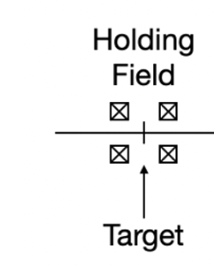
Optics solutions for the Moller polarimeter
Side view
Top view
Need to find solutions for the quad and dipole currents so that the Moller electron pair both make it through the dipole “slots” over a wide energy range

Slide 5
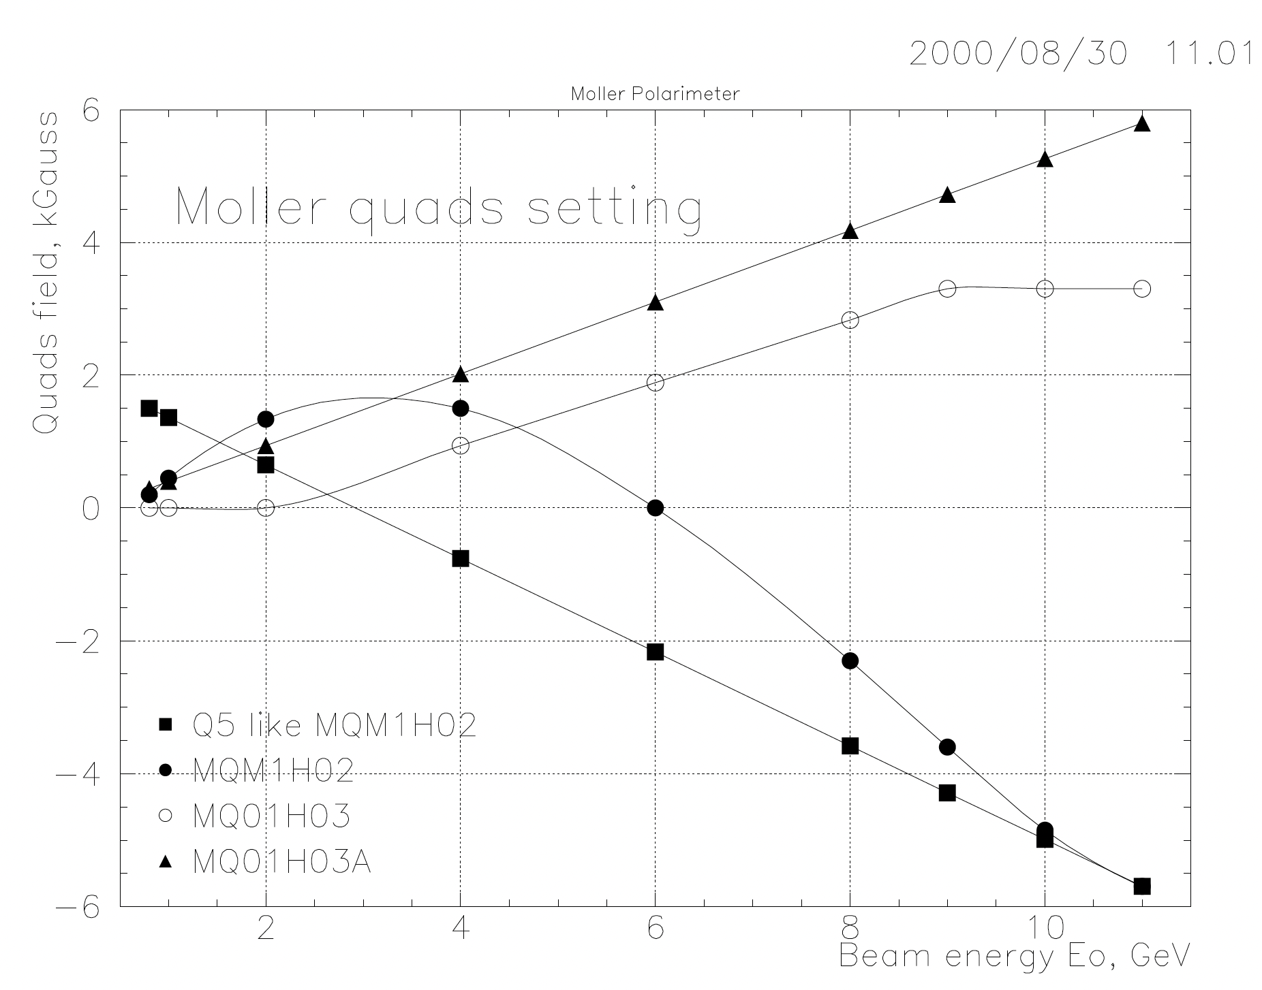
Optics solutions
Typically start from rough solution provided by Sasha and Eugene in their technote from 2000 and simulate solutions near this to find optimum (high rates, low sensitivity of Azz to quads)
Eric is leading the effort to determine optics settings
Takes a lot of computing power to run simulations so utilize OSG
Chudakov and Glamazdin technote

Slide 6
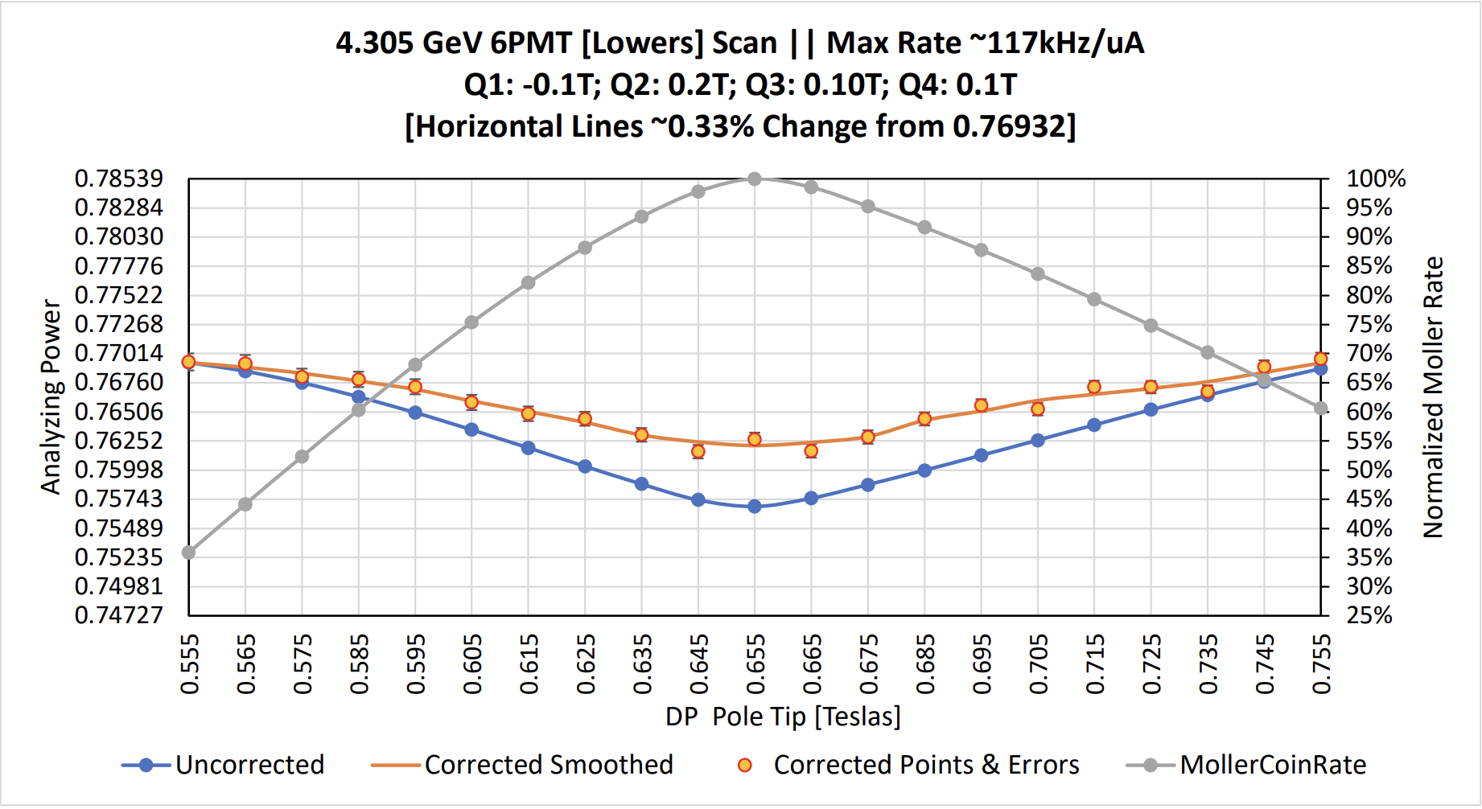
Optics solutions 2-pass
Scattering Rate
Azz corrected for Fermi motion
Azz
Dipole scan

Slide 7
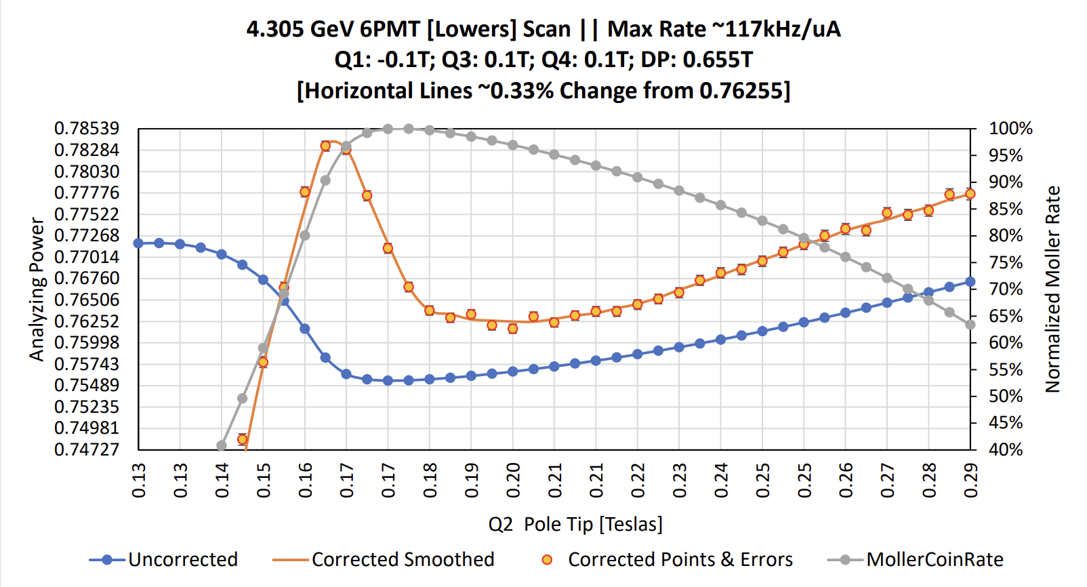
Optics solutions 2-pass
Procedure:
Find dipole scan rate maximum and set dipole to that
Set Q1=-0.1T, Q3=0.1T, Q4=0.1T and scan Q2 to find rate maximum
Set Q2 at 0.2T (~12%) above rate maximum setting.
Scattering Rate
0.2T
Azz corrected for Fermi motion
Levchuk
correction
Azz
Quadrupole scan

Slide 8
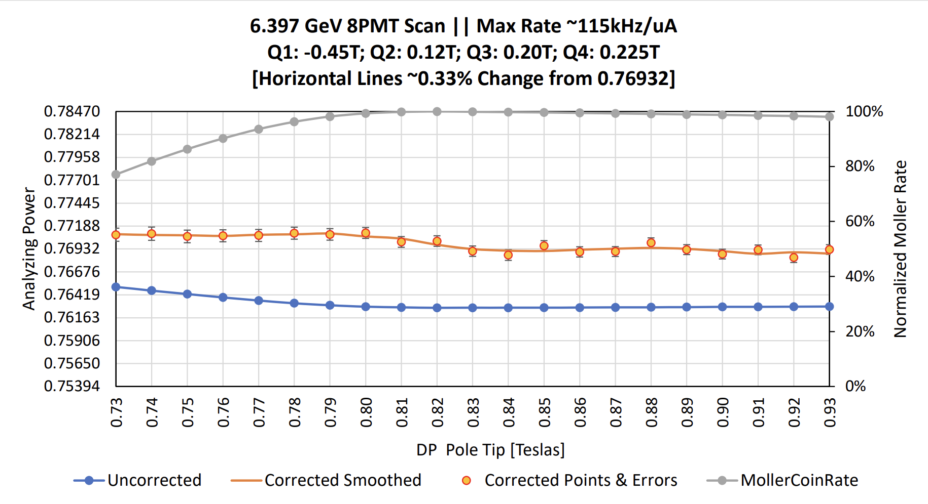
Optics solutions 3-pass
Scattering Rate
Azz corrected for Fermi motion
Azz
Dipole scan

Slide 9
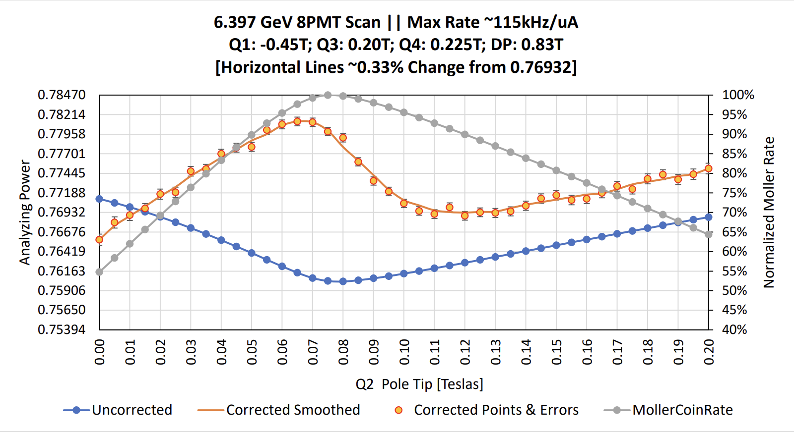
Optics solutions 3-pass
Procedure:
Find dipole scan rate maximum and set dipole to 0.4T (5%) above that point
Set Q1=-0.45T, Q3=0.20T, Q4=0.225T and scan Q2 to find rate maximum
Set Q2 at 0.47T (~63%) above rate maximum setting.
Scattering Rate
0.47T
Azz corrected for Fermi motion
Levchuk correction
Azz
Quadrupole scan

Slide 10
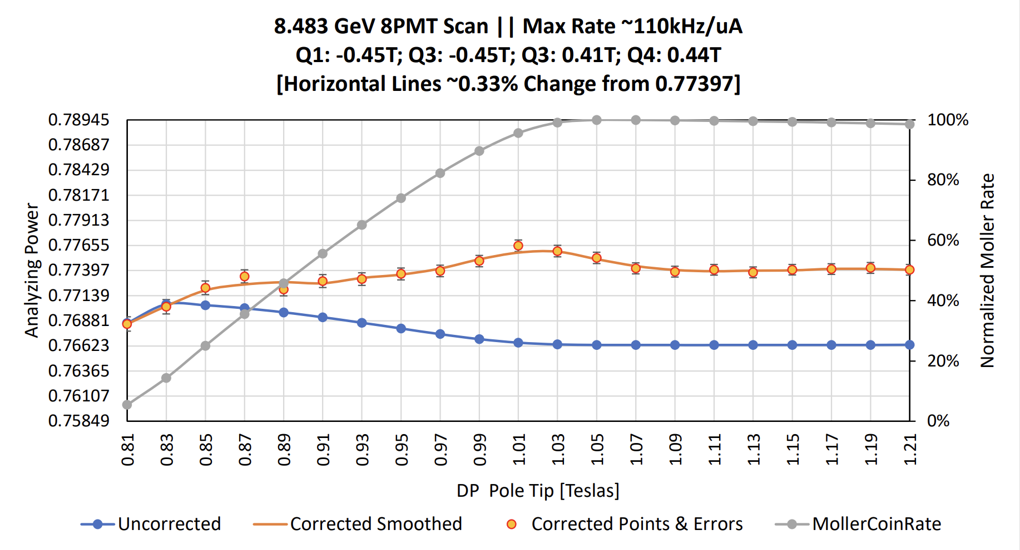
Optics solutions 4-pass
2
Scattering Rate
Azz corrected for Fermi motion
Azz
Dipole scan

Slide 11
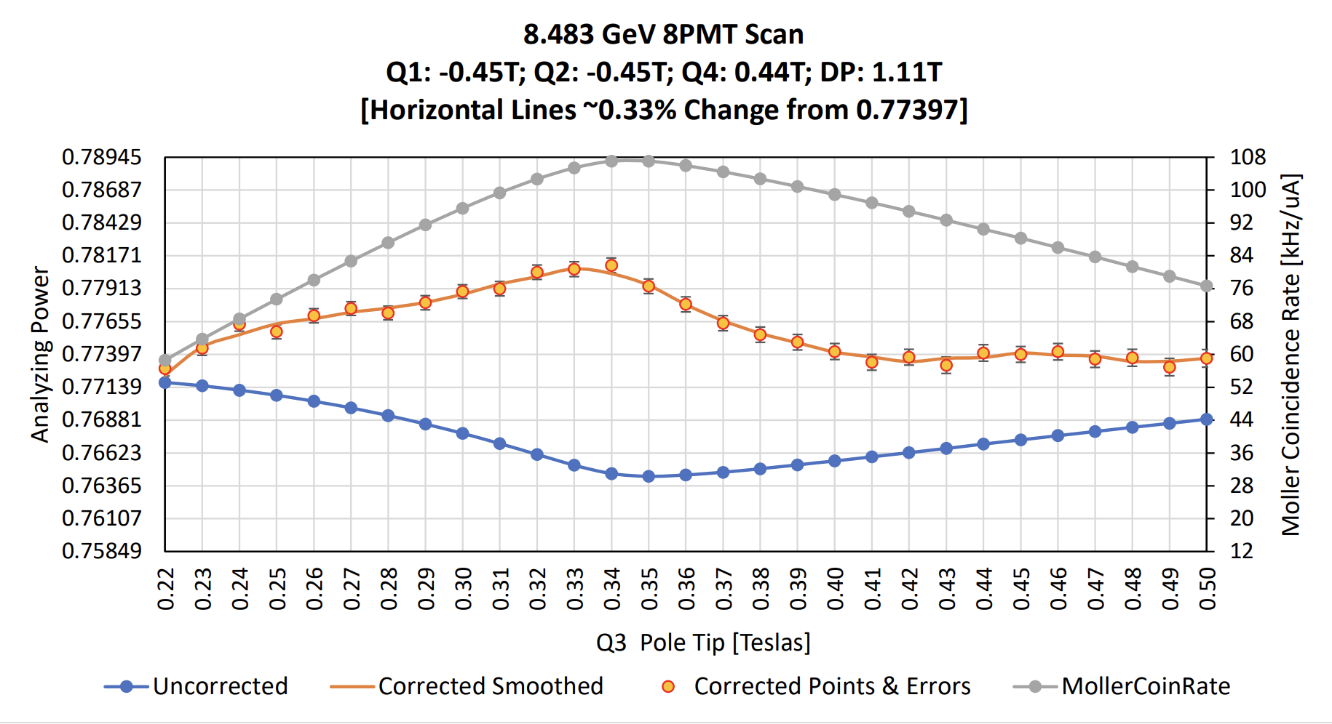
Optics solutions 4-pass
Procedure:
Find dipole scan rate maximum and set dipole 0.06T above that
Set Q1=-0.45T, Q2=-0.45T, Q4=0..44T and scan Q2 to find rate maximum
Set Q3 at 0.8T (~24%) above rate maximum setting.
Scattering Rate
Azz corrected for Fermi motion
0.8T
Levchuk correction
Azz
Quadrupole scan

Slide 12
GEn polarimetry requirements
Statistical limits of GEn sets the scale of systematic uncertainty from polarimetry at the 3% level
Polarization will not be optimal given that both A and B want polarized beam for the whole of this run period.
Both halls will run 10-20 degrees off longitudinal making us more sensitive to small energy/precession changes.
Passes | Energy(GeV) | # Days | Date Range | Suggested Number of Moller Measurements
1-pass | 2.1 | 10 | Sept. 30 to Oct. 9 | Unpolarized beam. Commissioning measurement?
2-pass | 4.2 | 8 | Oct 12-19 | 1 Moller measurement
3-pass | 6.3 | 30 | Oct 22 to Nov 20 | 2 Moller measurements
4-pass | 8.4 | 26 | Nov 23 to Dec 18 | 2 Moller measurements
4-pass | 8.4 | 56 | Jan 16 to Mar 12 | 4 Moller measurements

Slide 13
Discussion of measurements and error
Might take 1 shift to commission
If things go well expect 1 shift per measurement
MCC setup 2 hr
Magnet ramp 1 hr
Gain matching and calibration 2 hr
Measurements 2 hr
Ramp down and back out 1 hr
Systematic error on measurement per se will be about 1-1.2%
Systematic error on polarization for GEn will likely be larger
Most of the systematic error will come from extrapolation over time
Changes in photocathode (heat and reactivation, spot changes, QE depletion) can cause polarization changes
Drifts in energy lead to precession changes which can potentially give significant polarization shifts (not be fully longitudinal but sharing with Hall B)

Slide 14
Discussion of systematic error
Hall B wants polarized beam at 5-pass the whole run. Optimal Wien launch angle for B is -30.6 degrees.
B and A will average the optimal angle to share polarization equally.
The following table was constructed using 12 GeV Spin Doctor GUI
Sensitivity is either 1. change in polarization angle per 0.01% change in momentum or 2. % change longitudinal polarization per 0.01% change in momentum dp/p
Typical drifts over a few days are are 0.01-0.02%
Pass | Optimal Shared Wien Angle (deg) | Hall A degrees off longitudinal | Expected polarization (assumes 87%) | dP/P Sensitivity (deg/0.01%) | dP/P Sensitivity (%/0.01%)
2-pass | -23.5$°$ | -6.5$°$ | 86.4% | $$0.3°$$ | 0.06
3-pass | -14.3$°$ | -15.7$°$ | 83.8% | $$0.7°$$ | 0.32
4-pass | -47.4$°$ | 17.3$°$ | 83.1% | $$1.26°$$ | 0.68
These are from spin calculator but without a spin dance we could be several degrees off these estimates.

Slide 15
Hall A EPICS momentum drift tracker: PV = HALLA:dpp
Hall A fractional momentum changes tracked over Jan-Feb 2021
Note: it is actually more involved than this because a shift of the gradient between the N and S linacs with no overall shift in total momentum will also change the precession.
We will have to monitor these variables.

Slide 16
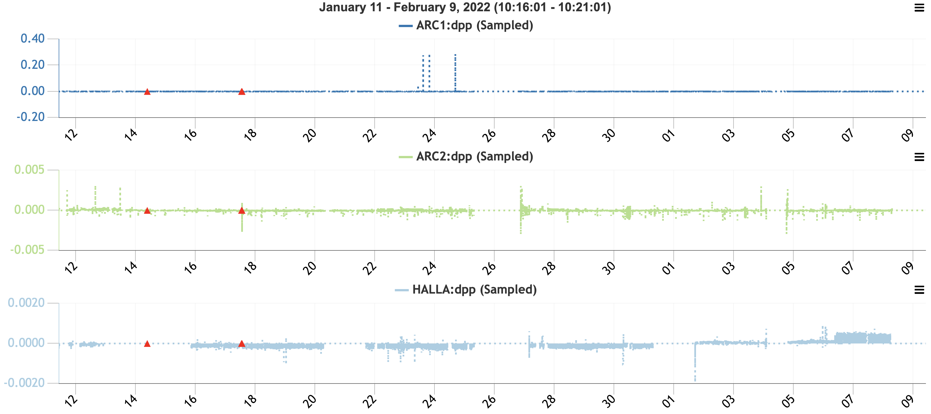
EPICS momentum drift tracker: HALLA:dpp, ARC1:dpp, ARC2:dpp

Slide 17
Proposed polarimetry schedule
Will need to monitor beam energy stability and measure polarization more frequently during 3 and 4 pass if required.
Changes to the photocathode like heat and reactivation and/or spot changes require new measurements.
Monitor QE of photocathode and when it becomes depleted (<0.1%) take measurements more often.
Prefer to take polarization measurements early in run periods in case spin is set wrong and needs to be optimized
Passes | Energy (GeV) | # of Days | Date Range | Measurement date | Personnel
1-pass | 2.1 | 10 | Sept. 30 to Oct. 9 | Commissioning measurement. | Don, Eric, Faraz, Bill
2-pass | 4.2 | 8 | Oct 12-19 | (Day) Thu. Oct. 13 | Don, Faraz, Bill
3-pass | 6.3 | 30 | Oct 22 to Nov 20 | (Day) Tue. Oct. 25 (Day) Fri. Nov. 11 | Bill, Faraz Eric, Faraz
4-pass | 8.4 | 26 | Nov 23 to Dec 18 | (Day) Tue Nov. 29 (Day) Tue Dec. 13 | Eric or Bill, Faraz Don, Faraz
4-pass | 8.4 | 56 | Jan 16 to Mar 12 | (Day) Wed. Jan. 18 Plus 3 more ~bi-weekly TBD | Eric, Faraz

Slide 18
Alternative polarimetry solutions
What if the Moller polarimeter fails? Do we have a back up solution?
Hall B takes regular Moller measurements with a systematic error of ~2%
We would then have to estimate the polarization magnitude from this and use a spin calculator to back out the relative angle between the two halls.
I wouldn’t trust the angle to better than a few degrees which gives an additional 2-3% systematic error at 3 and 4 pass but only 1% at 2-pass
If Hall B is willing to do a spin dance to calibrate the polarization angle we could probably cut the angle uncertainty to $±2°$ ($±$1%)
Further systematic error likely as energy/polarization drifts between measurements
Will not be able to reach 3% systematic error without Hall B spin dance(s). With spin dance maybe.
Mott polarimeter in the injector
Sub-percent level polarization measurements with Mott and then translate them into the Hall using spin calculator.
Joe Grames claims $±2°$ accuracy from precession model.
Could reach 3% with ~2 week measurement frequency if program could be supported by injector group.
Compton: could request that Dave G. wake up the sleeping Compton but it requires a serious time commitment (would need a student) and keeping the beam in the Compton chicane is not a turn key procedure but requires monitoring and trouble-shooting.

