Slide 1
Cable Routing and Installation
Don Jones
Mar. 7, 2024

Slide 2
Cable routing and installation
GEP-1
Cable carts
Cable inventory between platform and bunkers
1656 BNC signal cables
72 24ch high voltage extension cables
190 thermocouple extension cables
48 heater power cables
Plus CDET connections
Cable trays
Extra HV
cable coil

Slide 3
Cable routing and installation
GEP-2
Cable carts
Cable inventory between platform and bunkers
1656 BNC signal cables
Pull with winch or lots of hands
72 24ch high voltage extension cables
Remove and reconnect between moves
190 thermocouple extension cables
Very light so probably can just slide along
48 heater power cables
Remove and reconnect between moves
Plus CDET connections
Cable trays
Extra HV
cable coil

Slide 4
Cable routing and installation
GEP-3
Cable inventory between platform and bunkers
1656 BNC signal cables (not all made yet)
72 24ch high voltage extension cables (existing)
190 thermocouple extension cables (not started)
48 heater power cables (not started)
Plus CDET connections
Cable trays
Cable carts

Slide 5
Cable routing and installation
GEP-1
Cable carts
Cable inventory between platform and bunkers
1656 BNC signal cables
72 24ch high voltage extension cables
190 thermocouple extension cables
48 heater power cables
Plus CDET connections
Cable trays

Slide 6
Cable routing and installation
GEP-2
Cable inventory between platform and bunkers
1656 BNC signal cables
72 24ch high voltage extension cables
190 thermocouple extension cables
48 heater power cables
Plus CDET connections
Cable trays
Cable carts

Slide 7
Cable routing and installation
GEP-3
Cable inventory between platform and bunkers
1656 BNC signal cables (not all made yet)
72 24ch high voltage extension cables (existing)
190 thermocouple extension cables (not started)
48 heater power cables (not started)
Plus CDET connections
Cable carts
Cable trays

Slide 8
Proposed GEp-1 layout

Slide 9
Proposed GEp-3 layout

Slide 11
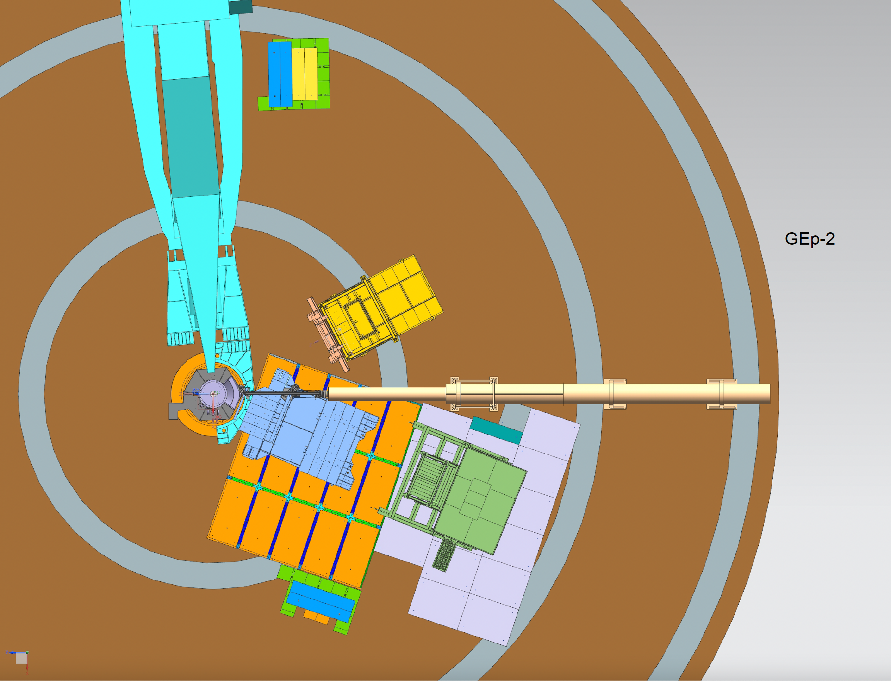

Slide 12
