Slide 1
ECal Weekly Meeting
Don Jones
04/04/2024

Slide 2
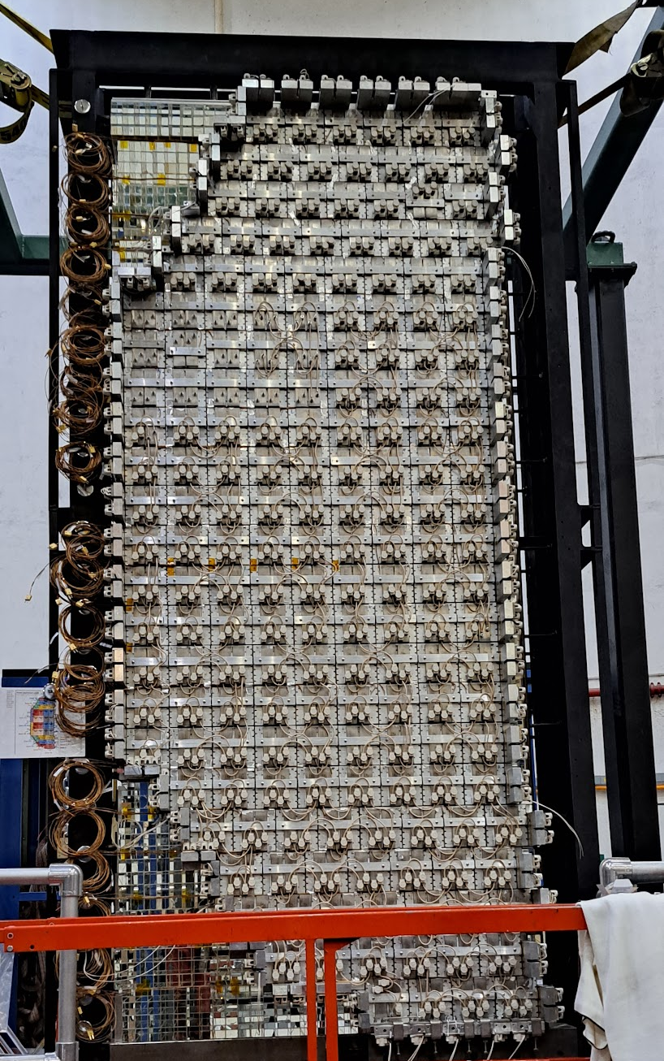
Discussion topics
Heater installation
Fans for NIM crates
HV cable rating
Prototype readiness
Clean up of ECal area in hall
Light-tight enclosure

